Slide 1
React Core Concepts
Course Code: CSC 4182
Course Title: Advanced Programming In Web Technologies
Dept. of Computer Science
Faculty of Science and Technology
Lecture No: | 1 | Week No: | 09 | Semester:
Lecturer: | Sazzad Hossain; sazzad@aiub.edu

Slide 2
Lecture Outline
React Core Concepts
Functional components
Props
State
Hooks
JSX
React Events

Slide 3
React Core Concepts
Following are the core ReactJS component That uses in NextJS
Functional Components
State and Props
React Hooks
JSX

Slide 4
Functional components
Functional components are the simplest type of React components. They are JavaScript functions that return JSX, describing what should be rendered on the screen. They do not have state or lifecycle methods, making them lightweight and easy to understand.
import React from 'react';
const FunctionalComponent () {
return <h1>Hello, I am a functional component!</h1>;
};

Slide 5
Props
Props (short for "properties") are a mechanism for passing data from a parent component to a child component. They allow you to customize and configure child components based on values provided by the parent component. Props are read-only and cannot be modified by the child component.

Slide 6
Props
//ParentComponent.js import React from 'react';
import ChildComponent from './ChildComponent';
const ParentComponent = () => {
// Define props data
const name = 'John Doe';
const age = 30;
return (
<div>
{/* Pass props to the ChildComponent */}
<ChildComponent name={name} age={age} />
</div>
);
};
export default ParentComponent;
//ChildComponent.js
import React from 'react';
const ChildComponent = (props) => {
// Access props data
const { name, age } = {props.name,props.age};
return (
<div>
<h1>Hello, {name}!</h1>
<p>You are {age} years old.</p>
</div>
);
};
export default ChildComponent;

Slide 7
State
State is a built-in feature that allows you to manage and store data within a component. It represents the mutable data that can change over time and affects how the component renders and behaves. When state data is updated, React automatically re-renders the component to reflect the changes.
State is a fundamental concept in React that enables dynamic and interactive user interfaces. It allows components to maintain their own local data and respond to user interactions, making React applications more interactive and responsive.

Slide 8
Hooks
React hooks are functions introduced in React 16.8 that allow functional components to have state and use lifecycle methods without the need for writing class components.
Hooks provide a more straightforward and reusable way to manage state and perform side effects in functional components.

Slide 9
Hooks
import React, { useState, useEffect } from 'react';
export default function CounterComponent = () => {
// useState hook to manage state
const [count, setCount] = useState(0);
// useEffect hook to perform side effects
useEffect(() => {
document.title = `Count: ${count}`;
}, [count]);
// Function to handle the increment button click
const handleIncrement = () => {
setCount(count + 1);
};
// Function to handle the decrement button click
const handleDecrement = () => {
setCount(count - 1);
};
return (
<div>
<h1>Counter: {count}</h1>
<button onClick={handleIncrement}>Increment</button>
<button onClick={handleDecrement}>Decrement</button>
</div>
);
};

Slide 10
Hooks
useState: The useState hook allows us to add state to functional components. We declare a state variable called count and its updater function setCount by calling useState(0) with an initial value of 0. We can now manage the state of count using setCount.
useEffect: The useEffect hook enables us to perform side effects in functional components. In this example, we use it to update the document title with the current count value. The useEffect hook takes a function as its first argument, and the second argument is an array of dependencies that specify when the effect should run. In this case, we pass [count] as the dependency array, so the effect will only run when the count state changes.

Slide 11
JSX
JSX (JavaScript XML) is a syntax extension for JavaScript used with React to describe the structure of UI components. It allows developers to write HTML-like code within JavaScript, making it easier to create and visualize the component's UI.

Slide 12
JSX
import React from 'react';
export default const GreetingComponent = () => {
const name = 'John Doe';
const showGreeting = true;
return (
<div>
{showGreeting ? (
<h1>Hello, {name}!</h1>
) : (
<p>No greeting available.</p>
)}
</div>
);
};

Slide 13
React Events
Just like HTML DOM events, React can perform actions based on user events.
React has the same events as HTML: click, change, mouseover etc.
React events are written in camelCase syntax:
onClick instead of onclick.
React event handlers are written inside curly braces:
onClick={shoot} instead of onClick="shoot()".
There are many events supported by React. Below are some popular events;

Slide 14
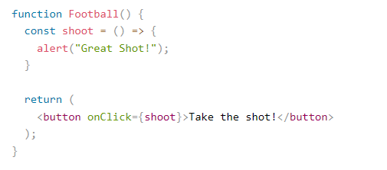
React Events
https://www.w3schools.com/react/showreact.asp?filename=demo2_react_events_handler

Slide 15
React Events
Keyboard Events
Focus Events
Form Events
Generic Events
Mouse Events
Pointer Events
Selection Events
Touch Events
UI Events
Wheel Events
Media Events
Image Events

Slide 16
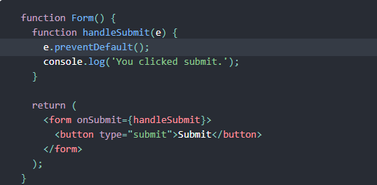
React Events
e is a synthetic event.
The preventDefault() method cancels the event if it is cancelable, meaning that the default action that belongs to the event will not occur.

Slide 17
References
W3Schools Online Web Tutorials, URL: http://www.w3schools.com
Next.js, URL: https://nextjs.org/
Mozilla Developer Networks, URL: https://developer.mozilla.org/

Slide 18
Thank You!

